Slide 1

Multi user chat SYSTEM
-Varsha
-Jaya Sree
-Renuka

Slide 2
Multi User Chat System is an application through which the user can communicate with other users connected in the same network area (LAN). This works under any operating system.
To establish a communication between the systems, we need simple socket connections in order to connect them in a network.
Socket programming uses the client socket and server socket methods to connect the local host to the named host and port.
The communication between various users is done using server client model.
Several client machines are connected to their dedicated server ports and communication is established.

Slide 3
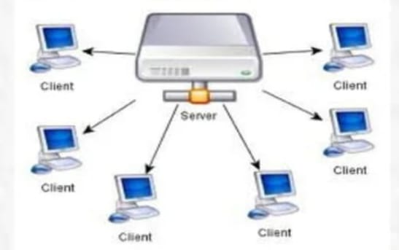
CLIENT:
Client is a user system which uses its server to get its program or action executed.

Slide 4
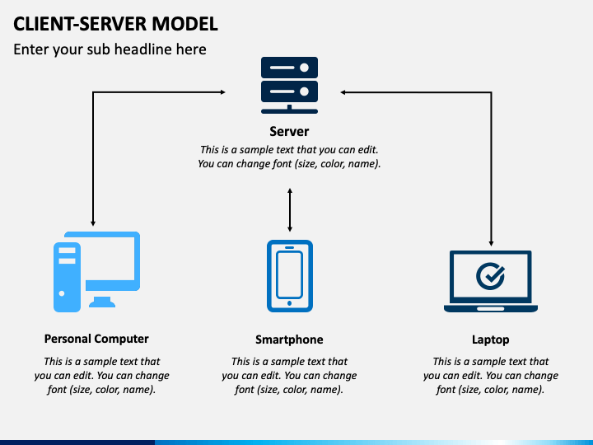
SERVER:
What is a server ?
A server is a system (software and suitable computer hardware) that responds to requests across a computer network to provide, or help to provide, a network service.
Servers can be run on a dedicated computer, but many networked computers are capable of hosting servers. In many cases, a computer can provide several services and have several servers running.
Servers are computer programs running to serve the requests of other programs, the clients. Thus, the server performs some task on behalf of clients. The clients typically connect to the server through the network but may run on the same computer. In the context of Internet Protocol (IP) networking, a server is a program that operates as a socket listener

Slide 5
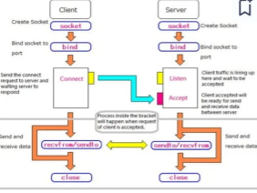

Slide 6
Step by step modules...
Listener class
While-Accept loop
Per-Thread class
While-Read/Write loop (Server side)
Removing dead connections
Client class
While-Read/Write loop (Client side)

Slide 7
LIMITATIONS:
The system's scalability may become problematic as the user base grows. Many concurrent users can put a strain on server resources and network traffic, especially when handling them in real-time.
With an increase in users, performance may suffer. Increased latency can cause delays in response times or message delivery, particularly during periods of high traffic.
Security issues with multi-user chat systems might include illegal access, data leaks, and malevolent activity like trolling, spamming, or phishing attempts. It is essential to have strong access control, encryption, and authentication systems.
It might be difficult to ensure interoperability across different operating systems and devices. When users use multiple platforms to access the chat system, they could encounter limits or inconsistent functionality.
Private organizations aim at having separate chat system tocommunicate with people and to share resources securely to them.

Slide 8
CONCLUSION:
Multi-user chat platforms are effective instruments for encouraging cooperation and communication among user groups. Although these systems offer many advantages, such as improved teamwork, real-time communication, and worldwide connectivity, they are not without drawbacks.
Challenges such as scalability issues, security concerns, privacy considerations, and user interface complexity must be addressed to ensure the effective functioning of such platforms.
Multi-user chat systems can be created by developers that prioritise reliable system design, apply strict security measures, create a positive user experience, and iteratively refine features based on user feedback. This allows for seamless communication experiences while mitigating potential drawbacks.
In the end, multi-user chat systems have the ability to significantly improve communication and collaboration across various communities and organisations with careful planning and continual improvement.

